Slide 1
Lesson 04 : Conditional Statements
By Fabian Quicken

Slide 2

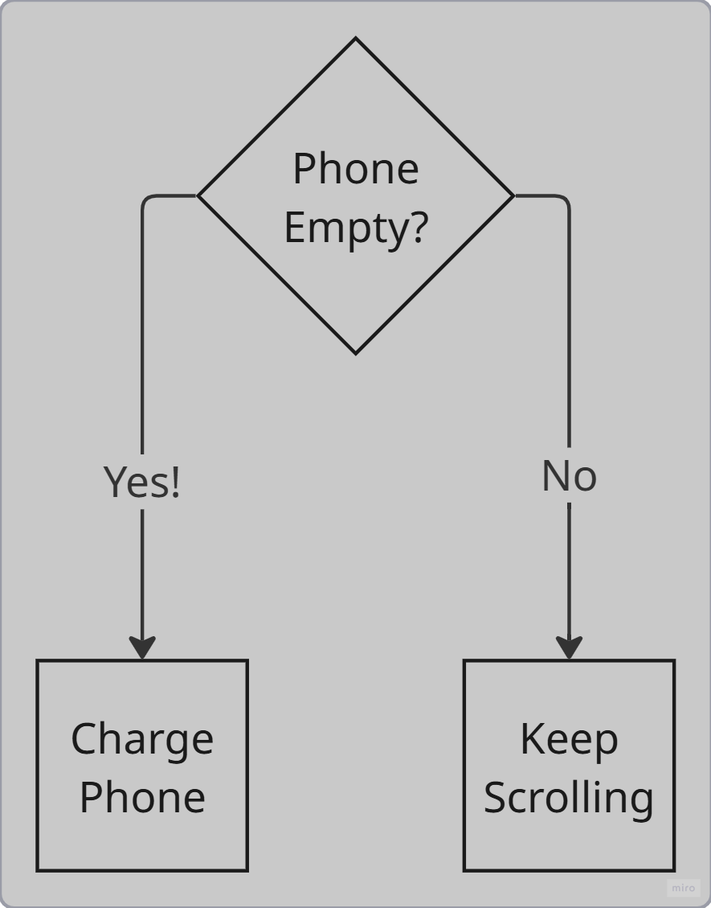
Let‘s stay real for a moment…

Slide 3
In Python:
if condition:
# do this
else:
# do this

Slide 4
Conditional Statements enable you to:
Adapt your code to given conditions
React based on your input
Take different courses of actions within one script
But what is a condition?

Slide 5
What is a Condition?
In python, a condition is a statement, that can either be:
True or False
„We love the python course.“
„Your phone battery is lower than 20%.“
„Fabi believes in statistics.“
Remember: True/False are Datatypes, therefore Conditional Statements underly the Boolean logic

Slide 6
Condition = Boolean expression
number > 5
b == b
x != 0
If statement
Tests for a condition
if condition:
# body of if statement
Body
Code block that is executed when the condition evaluates to „True“

Slide 7
Write this in your VSCode:
number = 1
if number > 0:
print(f’{number} is a positive number.’)
print(‘This is always executed.’)
Console Output:
>>
The block of code is seperated through indentation of the body. Typically via four spaces. If you press „Tab“ on your keyboard, the selected line(s) of code are indented four spaces automatically. The print statement is only executed, as long „number > 0“ evaluates to True. Try what happens, when you set the number to -1!

Slide 8
Write this in your VSCode:
number = 1
if number > 0:
print(f’{number} is a positive number.’)
print(‘This is always executed.’)
Console Output:
>>
The block of code is seperated through indentation of the body. Typically via four spaces. If you press „Tab“ on your keyboard, the selected line(s) of code are indented four spaces automatically. The print statement is only executed, as long „number > 0“ evaluates to True. Try what happens, when you set the number to -1!

Slide 9
Write this in your VSCode:
number = 1
if number > 0:
print(f’{number} is a positive number.’)
print(‘This is always executed.’)
Console Output:
>> 1 is a positive number.
>>
The block of code is seperated through indentation of the body. Typically via four spaces. If you press „Tab“ on your keyboard, the selected line(s) of code are indented four spaces automatically. The print statement is only executed, as long „number > 0“ evaluates to True. Try what happens, when you set the number to -1!

Slide 10
Write this in your VSCode:
number = 1
if number > 0:
print(f’{number} is a positive number.’)
print(‘This is always executed.’)
Console Output:
>> 1 is a positive number.
>> This is always executed.
The block of code is seperated through indentation of the body. Typically via four spaces. If you press „Tab“ on your keyboard, the selected line(s) of code are indented four spaces automatically. The print statement is only executed, as long „number > 0“ evaluates to True. Try what happens, when you set the number to -1!

Slide 11
number = -1
if number > 0:
print(f’{number} is a positive number.’)
print(‘This is always executed.’)
Console Output:
>>

Slide 12
number = -1
if number > 0:
print(f’{number} is a positive number.’)
print(‘This is always executed.’)
Console Output:
>>

Slide 13
number = -1
if number > 0:
print(f’{number} is a positive number.’)
print(‘This is always executed.’)
Console Output:
>>

Slide 14
number = -1
if number > 0:
print(f’{number} is a positive number.’)
print(‘This is always executed.’)
Console Output:
>> This is always executed.

Slide 15
If…else statement
When the condition of an „if“ statement is not met and it is followed by an „else“ statement, the code block following „else“ is executed
Imagine „else“ as „for all remaining cases“
number = -1
if number > 0:
print(f’{number} is a positive number.’)
else:
print(f’{number} is not a positive number.’)
print(‘This is always executed.’)
Console Output:
>> -1 is not a positive number.
>> This is always executed.

Slide 16

Let‘s take a ride….

Slide 17
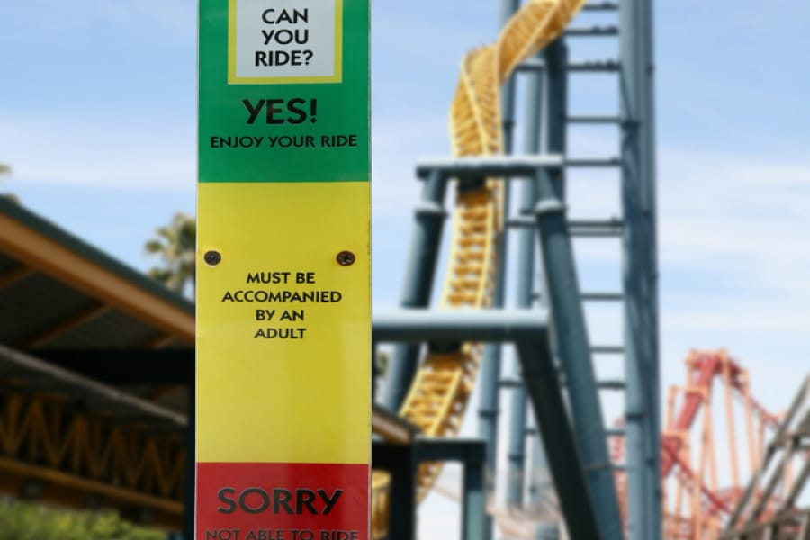
What if there are multiple conditions?

Slide 18
What if there are multiple conditions?
body_size = 160 # in cm
if body_size > 150:
print(’Enjoy the ride!’)
if body_size > 120:
print(’You have to be accompanied by an adult.’)
else:
print(’Sorry! Not able to ride.’)
Console Output:
>> Enjoy the ride!
>> You have to be accompanied by an adult.

Slide 19
What if there are multiple conditions?
body_size = 160 # in cm
if body_size > 150:
print(’Enjoy the ride!’)
if body_size > 120:
print(’You have to be accompanied by an adult.’)
else:
print(’Sorry! Not able to ride.’)
Console Output:
>> Enjoy the ride!
>> You have to be accompanied by an adult.

Slide 20
What if there are multiple conditions?
body_size = 160 # in cm
if body_size > 150:
print(’Enjoy the ride!’)
if body_size > 120:
print(’You have to be accompanied by an adult.’)
else:
print(’Sorry! Not able to ride.’)
Console Output:
>> Enjoy the ride!
>> You have to be accompanied by an adult.

Slide 21
What if there are multiple conditions?
body_size = 160 # in cm
if body_size > 150:
print(’Enjoy the ride!’)
if body_size > 120:
print(’You have to be accompanied by an adult.’)
else:
print(’Sorry! Not able to ride.’)
Console Output:
>> Enjoy the ride!
>> You have to be accompanied by an adult.

Slide 22
What if there are multiple conditions?
body_size = 160 # in cm
if body_size > 150:
print(’Enjoy the ride!’)
if body_size > 120:
print(’You have to be accompanied by an adult.’)
else:
print(’Sorry! Not able to ride.’)
Console Output:
>> Enjoy the ride!
>> You have to be accompanied by an adult.

Slide 23
What if there are multiple conditions?
body_size = 160 # in cm
if body_size > 150:
print(’Enjoy the ride!’)
if body_size > 120:
print(’You have to be accompanied by an adult.’)
else:
print(’Sorry! Not able to ride.’)
Console Output:
>> Enjoy the ride!
>> You have to be accompanied by an adult.

Slide 24
What if there are multiple conditions?
body_size = 160 # in cm
if body_size > 150:
print(’Enjoy the ride!’)
if body_size > 120:
print(’You have to be accompanied by an adult.’)
else:
print(’Sorry! Not able to ride.’)
Console Output:
>> Enjoy the ride!
>> You have to be accompanied by an adult.

Slide 25
Multiple conditions with if…elif…else statement
if condition1:
# do this
elif condition2:
# do this
else:
# do this

Slide 26
What if there are multiple conditions?
body_size = 160 # in cm
if body_size > 150:
print(’Enjoy the ride!’)
elif body_size > 120:
print(’You have to be accompanied by an adult.’)
else:
print(’Sorry! Not able to ride.’)
Console Output:
>> Enjoy the ride!

Slide 27
What if there are multiple conditions?
body_size = 160 # in cm
if body_size > 150:
print(’Enjoy the ride!’)
elif body_size > 120:
print(’You have to be accompanied by an adult.’)
else:
print(’Sorry! Not able to ride.’)
Console Output:
>> Enjoy the ride!

Slide 28
What if there are multiple conditions?
body_size = 160 # in cm
if body_size > 150:
print(’Enjoy the ride!’)
elif body_size > 120:
print(’You have to be accompanied by an adult.’)
else:
print(’Sorry! Not able to ride.’)
Console Output:
>> Enjoy the ride!

Slide 29
What if there are multiple conditions?
body_size = 160 # in cm
if body_size > 150:
print(’Enjoy the ride!’)
elif body_size > 120:
print(’You have to be accompanied by an adult.’)
else:
print(’Sorry! Not able to ride.’)
Console Output:
>> Enjoy the ride!

Slide 30
What if there are multiple conditions?
body_size = 160 # in cm
if body_size > 150:
print(’Enjoy the ride!’)
elif body_size > 120:
print(’You have to be accompanied by an adult.’)
else:
print(’Sorry! Not able to ride.’)
Console Output:
>> Enjoy the ride!

Slide 31
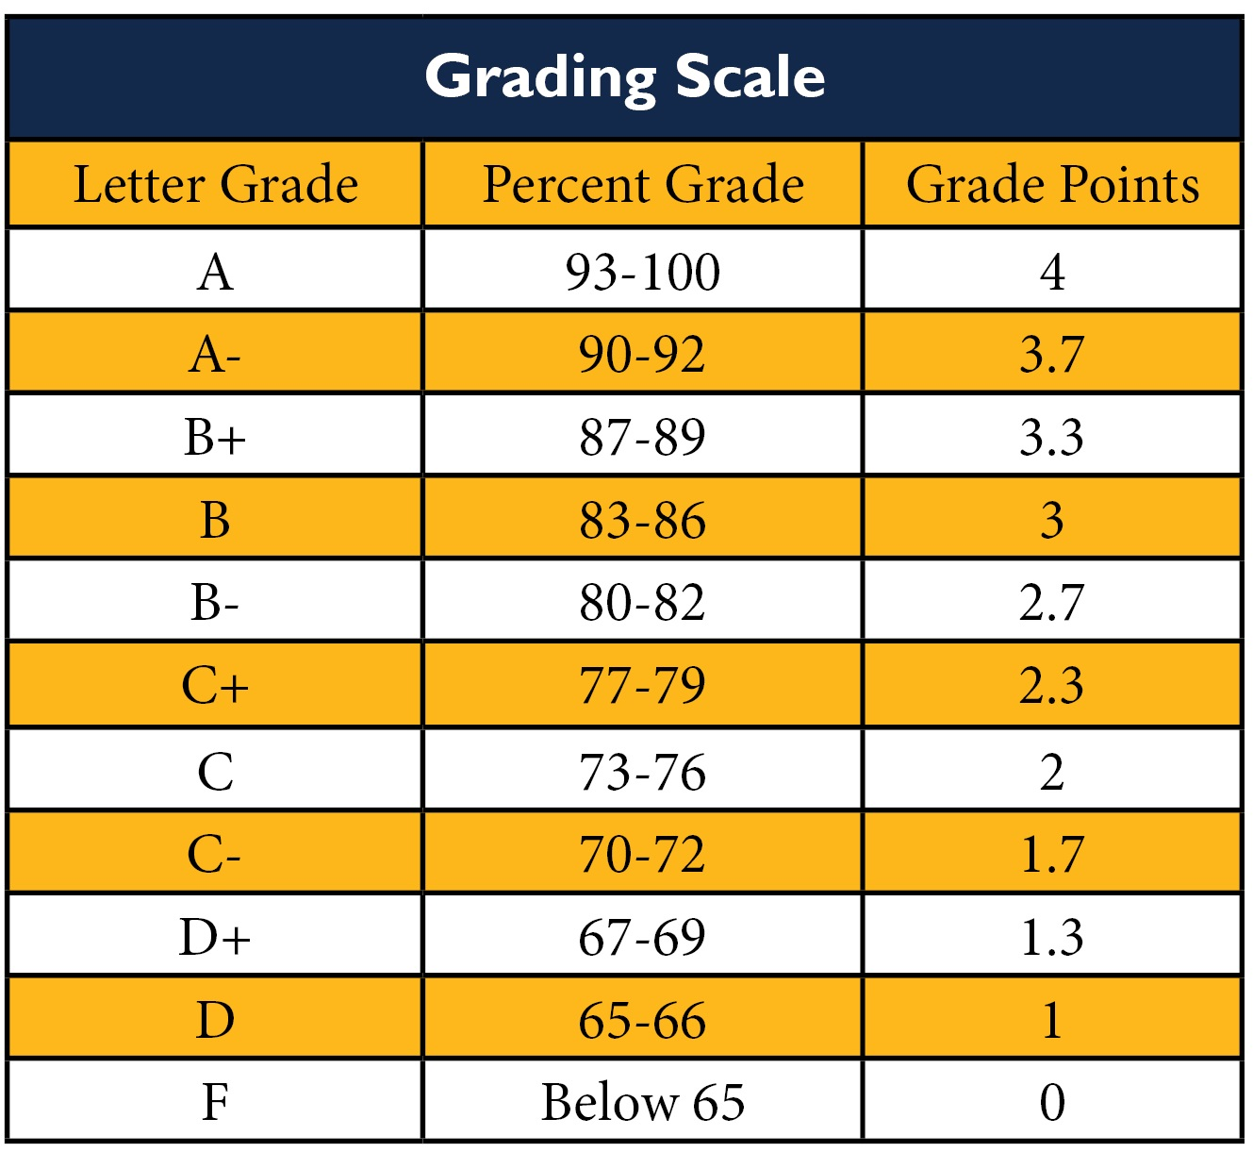
You can add as many „elif“ as you want!

Slide 32
Nested if statements
You can nest as many if statements into each other, as you like!
choice = “Cappuccino”
milk_level = 0.7
bean_level = 0.5
water_tank_full = True
if choice == “Cappuccino”:
if milk_level > 0.4:
if bean_level > 0.2:
if water_tank_full:
print(“Cappuccino in progress…”)

Slide 33
Boolean operators
„and“ links conditions
„and“ is strict, all have to be True
choice = “Cappuccino”
milk_level = 0.7
bean_level = 0.5
if choice == “Cappuccino”:
if milk_level > 0.4 and bean_level > 0.2:
print(“Cappuccino in progress…”)

Slide 34
Boolean operators
„or“ also links conditions
„or“ is lenient, only one condition needs to be „True“
weekend = False
holiday = True
if weekend or holiday:
print(“Store is closed.”)

Slide 35
Boolean operators
„not“ negates a boolean: not False == True
Increases readibility by avoiding writing „if has_ring == False“
has_ring = False
if not has_ring:
print(“Stolen! My Precious!”)

Slide 36
Hands-on Part

Slide 37
Some Debugging

Slide 38
Why is this suboptimal?
number = 11
if number > 0:
print(f’{number} is a positive number.’)
elif number > 10:
print(f’{number} is a large positive number.’)
else:
print(f’{number} is not positive.’)
number = 11
if number > 10:
print(f’{number} is a positive number.’)
if number > 0:
print(f’{number} is a large positive number.’)
else:
print(f’{number} is not positive.’)

Slide 39
Whats wrong here?
a = 1
b = 2
if a + b > 0:
print(f’The sum of a and b is positive.’)

Slide 40
Whats wrong here?
a = 1
b = 2
if a > b
print(f’{a} is larger than {b}.’)
elif a < b
print(f’{b} is larger than {a}.’)
else
print(f’{a} equals {b}.’)

Slide 41
Whats wrong here?
a = 1
b = 2
if a = b:
print(’Both numbers are equal.’)
if a != b:
print(’Both numbers are not equal.’)

